Slide 1
Ethos, Pathos and Logos
1. Ethos = character/credibility
2. Pathos = emotional appeal
3. Logos = logical argument; information that must make so much sense you MUST believe it/buy it.

Slide 2
Ethos
Speaker establishes moral credibility in the minds of the audience at the beginning of his or her speech.
We tend to believe people we respect
Someone who has authority; Someone who is likeable
A trusted doctor gives you advice.
You may not understand all of the medical reasoning behind the advice, but you nonetheless follow the directions because you believe that the doctors know what they are talking about.

Slide 3
Ethos = an appeal to ethics
Professional basketball players have established their credibility in sports by playing in the NBA.
If Kobe Bryant tells us that Vitamin water is the best drink for improving athletic performance, we believe that he knows what he is talking about.

Slide 4
Ethos – How to establish good character and credibilty
Use only credible, reliable sources to build your argument and cite those sources properly
Establish common ground with your audience. Acknowledge values and beliefs shared by both sides of the argument
Disclose why you are interested in this topic or what personal experiences you have had with the topic

Slide 5
Ethos – How to present
Strong voice
Demonstrate that you have done your research
Support reasons with appropriate, logical evidence

Slide 6
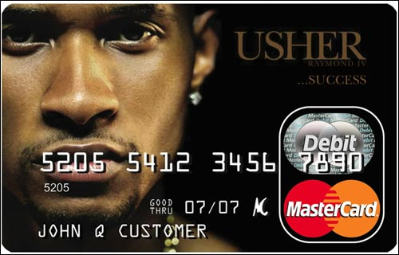

Slide 7
Pathos = an emotional argument
The use of emotional appeal.
Both words and pictures can achieve this appeal. In this picture, Haitian children are collecting water. Children and adults spend all day digging for water because most of Haiti does not have access to water.

Slide 8
Pathos
Pathos, emotional appeal, appeals to an audience’s needs, values, and emotional sensibilities
Can use sources such as interviews and individual stories to paint a more legitimate and moving picture of reality or illuminate the truth.
Majority of arguments in the popular press heavily dependent on appealing to your emotions.

Slide 9
Pathos: A How to:
Use language that involves the senses
Include an anecdote (personal experience)
Include connotative language (words that carry strong emotion) GUARANTEE
Use figurative language
Use description
Develop tone (attitude of speaker)

Slide 11
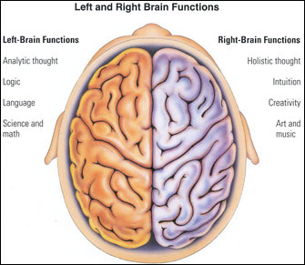
Logos Logos means logic
Logos
Provide evidence
Cite authorities
Quote research
Use facts

Slide 12
Logos

Slide 13
Let’s Practice!
“

Slide 14
Let’s Practice!
Identify the rhetorical strategy used in each commercial …
https://www.youtube.com/watch?v=7OIEFo2axGE&index=1&list=PL07FB5798655A15F6
https://www.youtube.com/watch?v=TPKgC8KPBMg
http://www.youtube.com/watch?v=1mhrsCFAmYs&list=PLB759AD429C749932
https://www.youtube.com/watch?v=SKL254Y_jtc

Slide 15
Answers…
1) Logos- Geico
2) Pathos - Dog
3) Pathos- Target Xmas
4) Ethos- Chrysler (Eminem and Motor City)

