Slide 1
How to Embed Quotations

Slide 2
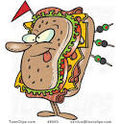
Support Sandwich
Context
Quote
Explanation

Slide 3
Goal
Strive for fluency between your words and the author’s words
If read aloud, it should be hard to tell where your words end and the author’s begin

Slide 4
NOT Embedded
The Gingerbread Man was obnoxious. “Run, run as fast as you can. You can’t catch me. I am the Gingerbread Man!” (5).

Slide 5
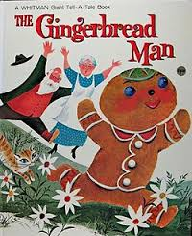
Embedded
The Gingerbread man was obnoxious. For instance, he taunted the old woman who made him as he left yelling, “Run, run as fast as you can. You can’t catch me. I’m the Gingerbread Man!” (5).

Slide 6
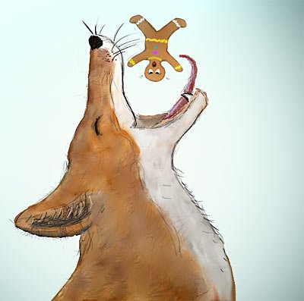
Avoid
This quote show us…
This quote explains…
Here is a quote that shows…
Punctuation marks come at the end of the sentence; not the quotation.
NO “And the fox went SLUUUURP and that was the end of the Gingerbread Man” (19)
YES “And the fox went SLUUURP and that was the end of the Gingerbread Man” (19).

