Slide 1
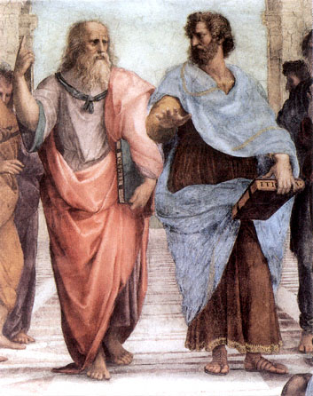
Ethos, Logos and Pathos
In approximately 300 B.C.E. Aristotle, who was a famous Greek philosopher, wrote a book entitled, “The Art of Rhetoric.” In his book, Aristotle identified the three methods of persuasion. He called them ethos, pathos and logos.
Aristotle
Plato
The Man
The Book

Slide 2
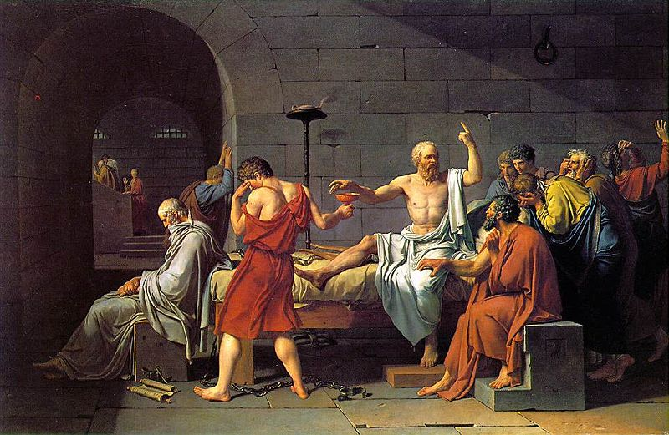
As you hear or read an argument you should ask yourself:
Is the argument persuasive?
To whom is the argument persuasive?
There are several ways to appeal to an audience.
Among them are appealing to logos, ethos and pathos.
These appeals are prevalent in almost all arguments.
This painting by Jaques –Louis David is called, “The Death of Socrates.”

Slide 3
Ethos, Pathos and Logos
1. Ethos = an ethical or moral argument
2. Pathos = an emotional argument
3. Logos = a logical argument

Slide 4
Ethos
The word "ethos" came from the Greek word ethikos meaning moral or showing moral character.
Speaker establishes moral credibility in the minds of the audience at the beginning of his or her speech.
We tend to believe people we respect
Someone who has authority; Someone who is likeable
For example, when a trusted doctor gives you advice, you may not understand all of the medical reasoning behind the advice, but you nonetheless follow the directions because you believe that the doctor knows what s/he is talking about.

Slide 5
Ethos = an appeal to ethics
Ethos: Ethos is related to the English word ethics and refers to the trustworthiness of the speaker/writer.
Ethos is an effective persuasive strategy because when we believe that the speaker does not intend to do us harm, we are more willing to listen to what s/he has to say.
For example, professional basketball players have established their credibility in sports by playing in the NBA. If Kobe Bryant tells us that Vitamin water is the best drink for improving athletic performance, we believe that he knows what he is talking about.

Slide 7
Pathos = an emotional argument
The use of emotional appeal.
Both words and pictures can achieve this appeal. In this picture, Haitian children are collecting water. Children and adults spend all day digging for water because most of Haiti does not have access to water.

Slide 8
Pathos
Pathos: Pathos is related to the words pathetic, sympathy and empathy.
You accept a claim based on how it makes you feel without fully analyzing the rationale behind the claim -- Pit Bulls
You are persuaded through fear, love, patriotism, guilt, hate or joy.
Majority of arguments in the popular press heavily dependent on appealing to your emotions.
We should not react to emotional arguments without fully considering all facts.

Slide 10
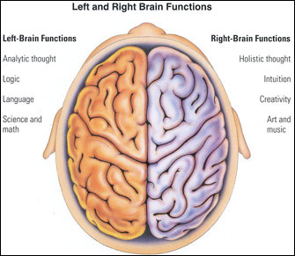
Logos Logos means logic
Logos refers to any attempt to appeal to the intellect: making a logical argument.
Logos appeals to the left side of the audience's brain.
Reasoning and facts to make its decision.
Numbers, polls and statistics are also examples of the persuasive use of logic.

Slide 11
Logos

Slide 12
REVIEW Ethos, Pathos and Logos
1. Ethos = an ethical or moral argument
2. Pathos = an emotional argument
3. Logos = a logical argument

Slide 13
Let’s Practice!
Identify the rhetorical strategy used in each commercial …
https://www.youtube.com/watch?v=7OIEFo2axGE&index=1&list=PL07FB5798655A15F6
http://www.youtube.com/watch?v=ZKB9fgQpkLk&list=PLB759AD429C749932
http://www.youtube.com/watch?v=1mhrsCFAmYs&list=PLB759AD429C749932
https://www.youtube.com/watch?v=SKL254Y_jtc

Slide 14
Answers…
1) Logos- Geico
2) Pathos - Dog
3) Pathos- Target Xmas
4) Ethos- Chrysler (Eminem and Motor City)

