Slide 1
MyBlueprint Tutorial
Go to SD67
2. Scroll down to myBlueprint.ca
3. Click on Sign up
4. Select school – Penticton Secondary
5. Click on Create Account

Slide 2
6. Select your Grade and click Continue

Slide 3
7. Enter in your information and click Create My Account Note: Be sure to enter your full name correctly as I will be using your full name in order to check your work and use a personal email address.

Slide 4
8. Validate your email

Slide 5
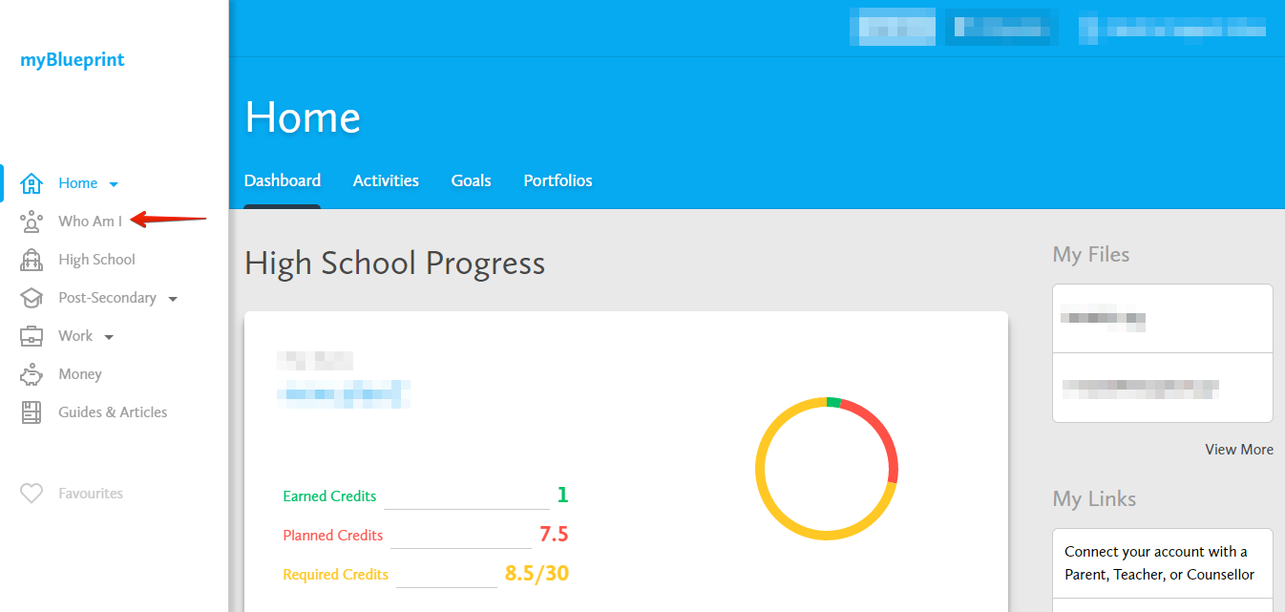
9. Click on Who Am I? from the menu on the left side

Slide 6
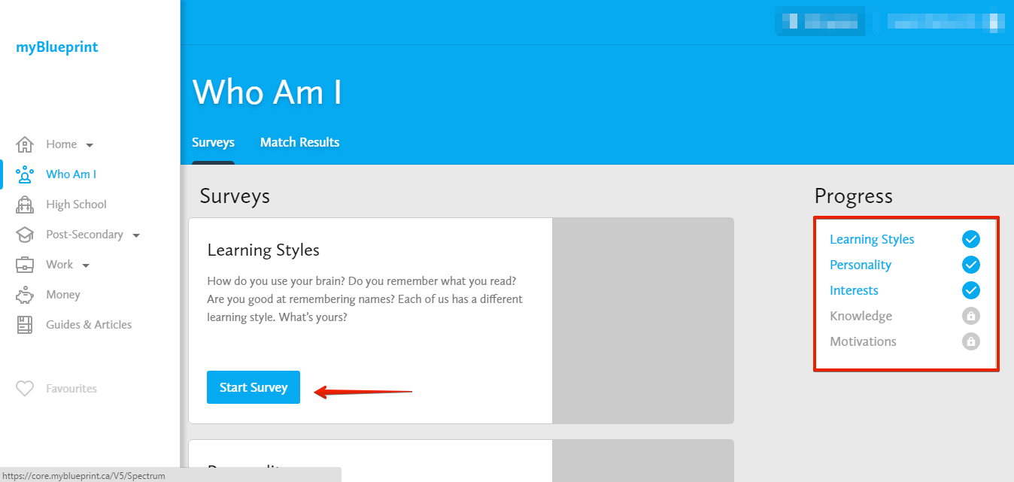
10. Complete the Learning Styles, Personality, Interests, Knowledge, and Motivations Survey

Slide 7
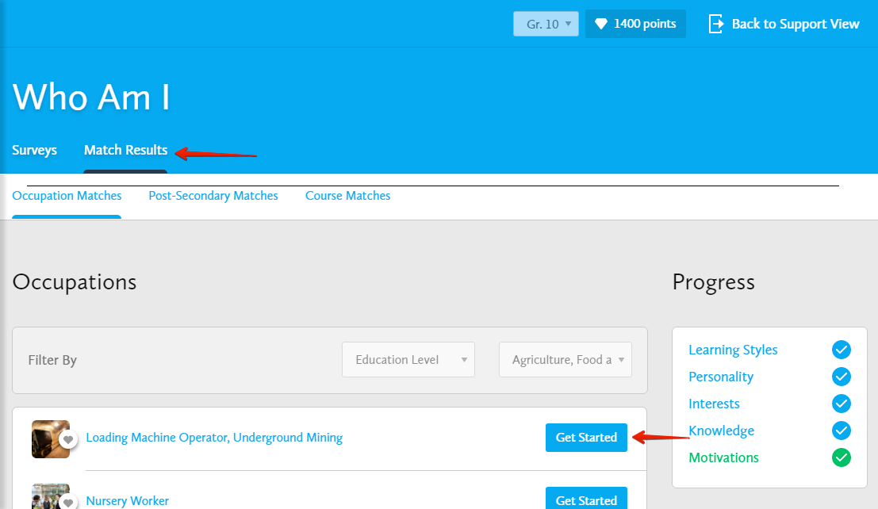
11. Switch to the Match Results tab and complete the Match Survey

