Slide 1

Review – 3 Types of Sentences

Slide 2
Write a simple sentence about the picture.

Slide 3

Add more detail to your sentence. Write a compound sentence.
FANBOYS

Slide 4

Add even more detail. Add a semicolon or a conjunctive adverb
(furthermore, meanwhile, therefore, hence, moreover, thus, however, and nevertheless).

Slide 5
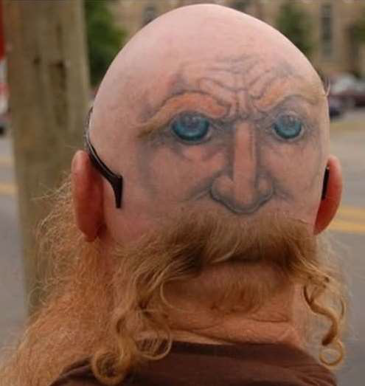

Slide 6
Now that you see the whole image, alter your sentence so that it tells the full story. Write a complex sentence.
TIME CAUSE & EFFECT OPPOSITION CONDITION after because although if before since though unless when now that even though only if while as whereas whether or not since in order that while even if until so in case (that) RELATIVE PRONOUNS: who whoever that whom whomever which whichever

Slide 7
A complex sentence makes clear which ideas are most important.
Examples:
1.Although Josh reads novels, Dawson reads comics.
2.When she was younger, Faith had many dogs.

Slide 8
Dependent, Independent OR
Independent (no comma) Dependent

Slide 9
Compound-Complex Sentences
A compound-complex sentence has one complex
sentence joined to a simple sentence with a
conjunction.
Example:
While Tom reads novels, Jack reads comics, but Sam
only reads magazines.

Slide 10
Connectors for Compound-Complex Sentences
The complex and simple sentences may be joined by a coordinating conjunction(FANBOYS) or conjunctive adverbs.
Examples of Conjunctive Adverbs:
furthermore, meanwhile, therefore, hence, moreover, thus, however, and nevertheless
Examples of Coordinating Conjunctions:
for, and, nor, but, or, yet, and so.

Slide 11
Compound-Complex Sentences Tips
Remember that a compound-complex sentence contains at least 2 complete sentences joined by a conjunction.
Remember that a compound-complex sentence also contains a dependent clause (or introductory clause).
Remember that the dependent clause must be introduced using a transitional word or phrase.

Slide 12
SIX Pictures; SIX Sentences
On the following slides there are pictures: write ONE sentence for each picture using one of the options below. (Make sure you rotate through the different options to give you lots of practice!)
Write SIX sentences
1. Simple 2. Compound FANBOYS 3. Compound Conjunctive Adverb 4.Compound Semi-colon (;) 5. Complex 6. Compound-Complex

Slide 13
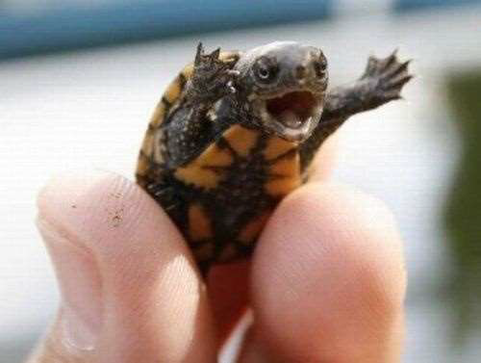

Slide 15
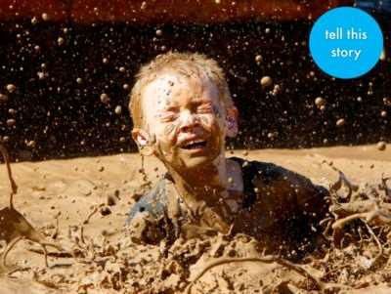

Slide 16
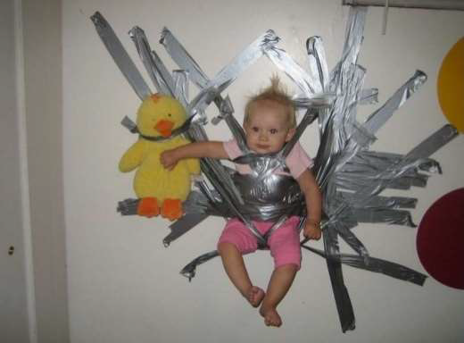

Slide 18


Slide 20
      Self-Check
      For Compound-Complex
Does your sentence have at least 2 independent clauses? Underline them.
Are your sentences joined by a conjunction? Draw a box around it.
Does your sentence have a dependent clause? Circle it.
Does your dependent clause start with a transitional word or phrase? Draw a box around it.

Slide 21
Transitional Words or Phrases
Transitional words or phrases connect one idea to another.
  To Show Chronological Order -afterward, again, also, as long as, as soon as, at last, before, besides, earlier, equally important, furthermore, meanwhile, moreover, simultaneously, soon, then, therefore, too, until, when
  To Indicate Spatial Order -above, below, beyond, elsewhere, farther on, here, near, nearby
  To Connect Examples or Show Emphasis -for example, for instance, in fact, of course, specifically, such as
  To Compare and Contrast -in comparison, also, likewise, similarly, although, on the contrary, and yet, but, despite, even so, however, yet
  To Trace Cause and Effect -because, consequently, otherwise, since, then, therefore
  To Summarize -in short, in simpler terms, in summary, that is, to summarize

