Slide 1
Human Rights Act 1977

Slide 2
Jane Elliott - Blue Eyes and Brown Eyes Experiment
3rd Grade Teacher Jane Elliott
Experiment conducted on the days after Martin Luther King assassination (1968)
Wanted to explain discrimination to 8 year olds.
Experiment deals with stereotypes, prejudice, discrimination, and the creation of in-group bias.

Slide 3
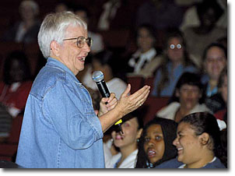
"Oh, Great Spirit, keep me from ever judging a man until I have walked a mile in his moccasins."

Slide 4
Reflection
What are human rights?
How does the experiment connect to human rights?
How do you think, feel and wonder about the experiment?

Slide 5
What is the Canadian Human Rights Act?
Anti-Discrimination Legislation
…to the principle that all individuals should have an opportunity equal with other individuals to make for themselves the lives that they are able and wish to have and to have their needs accommodated, consistent with their duties and obligations as members of society…

Slide 6
Definition of Discrimination
…the Act prohibits any practices or conduct that involves treating people “differently, negatively or adversely,” unless there is “good reason” to do so.

Slide 7
Employment
A person cannot be denied a job, or released from employment, due to some personal characteristic, such as race or disability, that does not affect job performance or that can be accommodated.

Slide 8
Equal pay
Persons must be paid the same for jobs of equal value. In other words, an employer cannot pay a female employee less than a male employee for performing a job of equal value.

Slide 9
Provision of goods and services
Businesses cannot refuse to provide a good or service to an individual simply on the grounds of some personal characteristic. In example, a bank cannot ask a married woman for her spouse’s signature when applying for a loan, on the grounds that she is a woman.

Slide 10
Hate speech
The Act also prohibits the communication of hate messages. This includes messages that encourage discrimination, hatred of a group, or which involve comments that are demeaning to a group.

Slide 11
Grounds of Discrimination
race
national or ethnic origin
colour
religion
age
sex (including pregnancy and childbirth)
sexual orientation
marital status
family status
mental or physical disability (including previous or present drug or alcohol dependence)
pardoned conviction

Slide 12
Exemptions to the Act
Mandatory retirement.
the Act allows employers to terminate or refuse employment once employees or prospective employees have reached the maximum age of employment set out by law.

