Slide 1
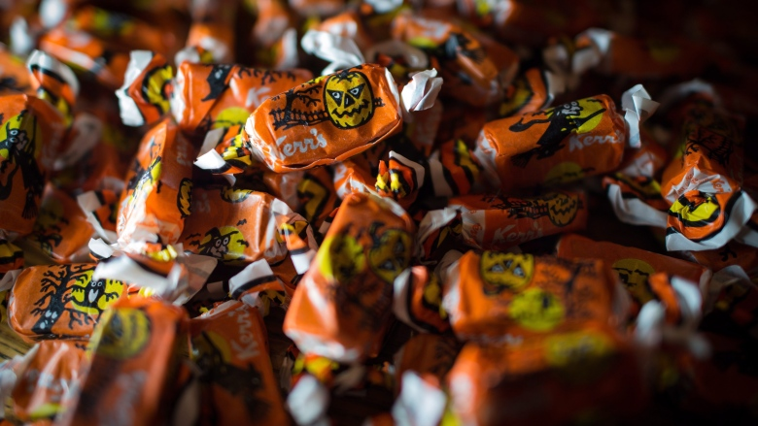

Slide 2
"They get stuck to the wrapper, they get stuck to your teeth and it's got this weird earthy taste that's disgusting to almost everyone under the age of 65." --Tristin Hopper, a National Post reporter

Slide 3
"This Halloween don't scare kids with that wretched Kerr's molasses candy that you hated as a kid”

Slide 4
Put a positive spin on it
Promotes the kisses on its website as "traditional Halloween taffy“
Candies contain 10 per cent real molasses.
Used the same recipe to make them for more than 70 years.

Slide 5
If you think you are…
1. Too compulsive: Your friends think you’re nuts because everything in your locker is in alphabetical order.
2. Too argumentative: You always tell people exactly what you think and feel—even if it’s about them.

Slide 6
Then say this to an employer…
1. Too Compulsive?
Strong organizational skills and an ability to plan ahead
Do a thorough job
2. Too Argumentative?
Confident and deal with issues directly
Enjoy taking on a challenge

Slide 7
If you think you are…
3. Too lazy: You always start essays the night before they’re due. If there’s a reason not to do something, you’ll find it.
4. Too loud: When you talk, people can’t help but hear you—you love being the centre of attention.

Slide 8
Then say this to an employer…
3. Too lazy?
Can work with short deadlines and under pressure.
4. Too loud?
Enthusiastic and outgoing.
Interact easily with groups.

Slide 9
If you think you are…
5. Too stubborn: You hate to back down and don’t like to admit when you’re wrong. 6. Too talkative: No one can get a word in when you’re in the conversation—you are the conversation!

Slide 10
Then say to an employer…
5. Too stubborn? Persistent
Always carry a project through to the end
6. Too Talkative? Articulate and enjoy public speaking
Persuasive and present ideas well

Slide 11
If you think you are…
7. Too weird:
You dance to a different beat and do things your own way.
8. Too indifferent:
You never seem to have a strong opinion and just can’t get excited about anything

Slide 12
Then say to an employer…
7. Too weird?
Innovative
Always offers a fresh perspective
Enjoys taking the initiative
8. Too indifferent? Adaptable
Can be counted on to stay calm in stressful situations

Slide 13
If you think you are…
Too sensitive: You take everything to heart.
Too serious: Everything is important. You never seem to relax.

Slide 14
Then say to an employer…
9. Too sensitive? Caring, perceptive person with strong people skills.
Desire to please others.
10. Too serious? Careful and reliable.
Good at considering all the options

Slide 15
If you think you are…
Too extreme: You always overreact—every event in your life seems to be out of a soap opera.
Too shy: Meeting new people make you really nervous—you end up doing most things alone.

Slide 16
Then say to an employer…
11. Too extreme? Imaginative.
Creativity leads to good ideas. 12. Too shy? Self-motivated
Work well independently
Need little supervision

Slide 17
Reflection – What I would say to an employer…
Write about FIVE traits
Turn them into a positive
“I am persistent…”
Provide an example from your life
“For example, …” Imagine an employer stating, “Describe a time when you demonstrated innovation.”

